Slide 1

CREATE AND DEPLOY A FLASK WEB APPLICATION IN AN AWS EC2 INSTANCE
Department of Computer Science
BATCH 5
PROJECT GUIDE: Sitha Kumari Mam
Members of the Batch:
18131A05C6 O. NAGARAJU
18131A05D3 P. VAMSI KRISHNA
18131A05D4 P. SIDHARTH
18131A05G2 S. TEJESWAR REDDY

Slide 2
ABSTRACT
This report briefly explains how to use frameworks and develop an application in Python in a very short time. An application to manage employee CRUD database is taken as a case study. An attempt is made to provide High quality user experience in the application. The web application will be hosted in a public cloud using AWS, Cloud services provided by Amazon. EC2 will be useful in launching virtual servers, configure security and networking, and manage storage. Amazon provides an enriched portal to do all the required administrative actions in a simple way. VPC (Virtual Private Cloud) feature provided by Amazon will enhance the security to Website. To segregate the network traffic to this specific application from other traffic to the same web site, SUBNET concept will be explored. This may help in performance improvement of the servers of the website of the organisation.
In a traditional web hosting environment, Web servers may not respond if there are huge number of requests per second at peak times due to limitation of hardware resources. However, in the cloud environment, the resources are many and elasticity feature of a cloud will smoothen the peak loads. Cloud environments provides automatic balancing of work load among storage servers and compute servers. Access to the AWS resources can be restricted using the Identity and Access Management (IAM). AWS also provides VPC, which can be used to launch AWS resources in a logically isolated virtual network.
Flask, popular Python web framework, will be explored which helps in developing web applications quickly in an integrated way with MySQL.

Slide 3
INTRODUCTION
INTRODUCTION
Flask CRUD Application with SQLAlchemy
We are going to build a Flask web application that allows us to create employee, read employee data from mysql database, update employee data and also delete employee (CRUD).
What is Flask ?
Flask is a web framework that provides tools, libraries and technologies that allow you to build a web application.
What is SQLAlchemy ?
SQLAlchemy is the Python SQL toolkit and Object Relational Mapper that gives application developers the full power and flexibility of SQL.
.

Slide 4
EXISTING STATUS OF WORK
DESIGNING A FLASK APPLICATION : COMPLETED
CRUD DATABASE CONNECTIVITY : COMPLETED
SETTING UP A VPC : COMPLETED
LAUNCHING AN EC2 INSTANCE : RUNNING
GITHUB CLONING AND SSH CLIENT : COMPLETE
LAUNCHING THE FLASK APPLICATION : COMPLETED

Slide 5
DRAWBACKS OF EXISTING WORK
Importing the project files from windows to Linux ec2 instance using putty SSH client is a complicated task.
General CRUD Database Connectivity is done through XAMPP Server and MYSQL.
Manually installing commands every time we launch a new instance in the Linux terminal is a tiresome process.

Slide 6
Proposed work to overcome the drawbacks:
We can create a git hub repository to push all our project files and later use git hub cloning later in the Linux terminal.
SQL Lite can be used instead of using xampp and mysql.
We can create a requirents.txt that captures the software functional requirements and can be used later for newly created instances.

Slide 7
MINIMUM REQUIRMENTS:
click==8.0.3
colorama==0.4.4
Flask==2.0.2
Flask-SQLAlchemy==2.5.1
greenlet==1.1.2
itsdangerous==2.0.1
Jinja2==3.0.3
MarkupSafe==2.0.1
SQLAlchemy==1.4.27
Werkzeug==2.0.2

Slide 8
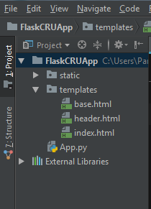
Installation:
pip install Flask
pip install Flask-SQL Alchemy
pip install Jinja2
create two folders one for your static files.
Download Bootstrap and paste the downloaded folder inside the static folder
Create a text folder called requirements.txt
as it will be useful to capture and store the
software functional requirements.
Store the html files in a folder called templates.

Slide 9
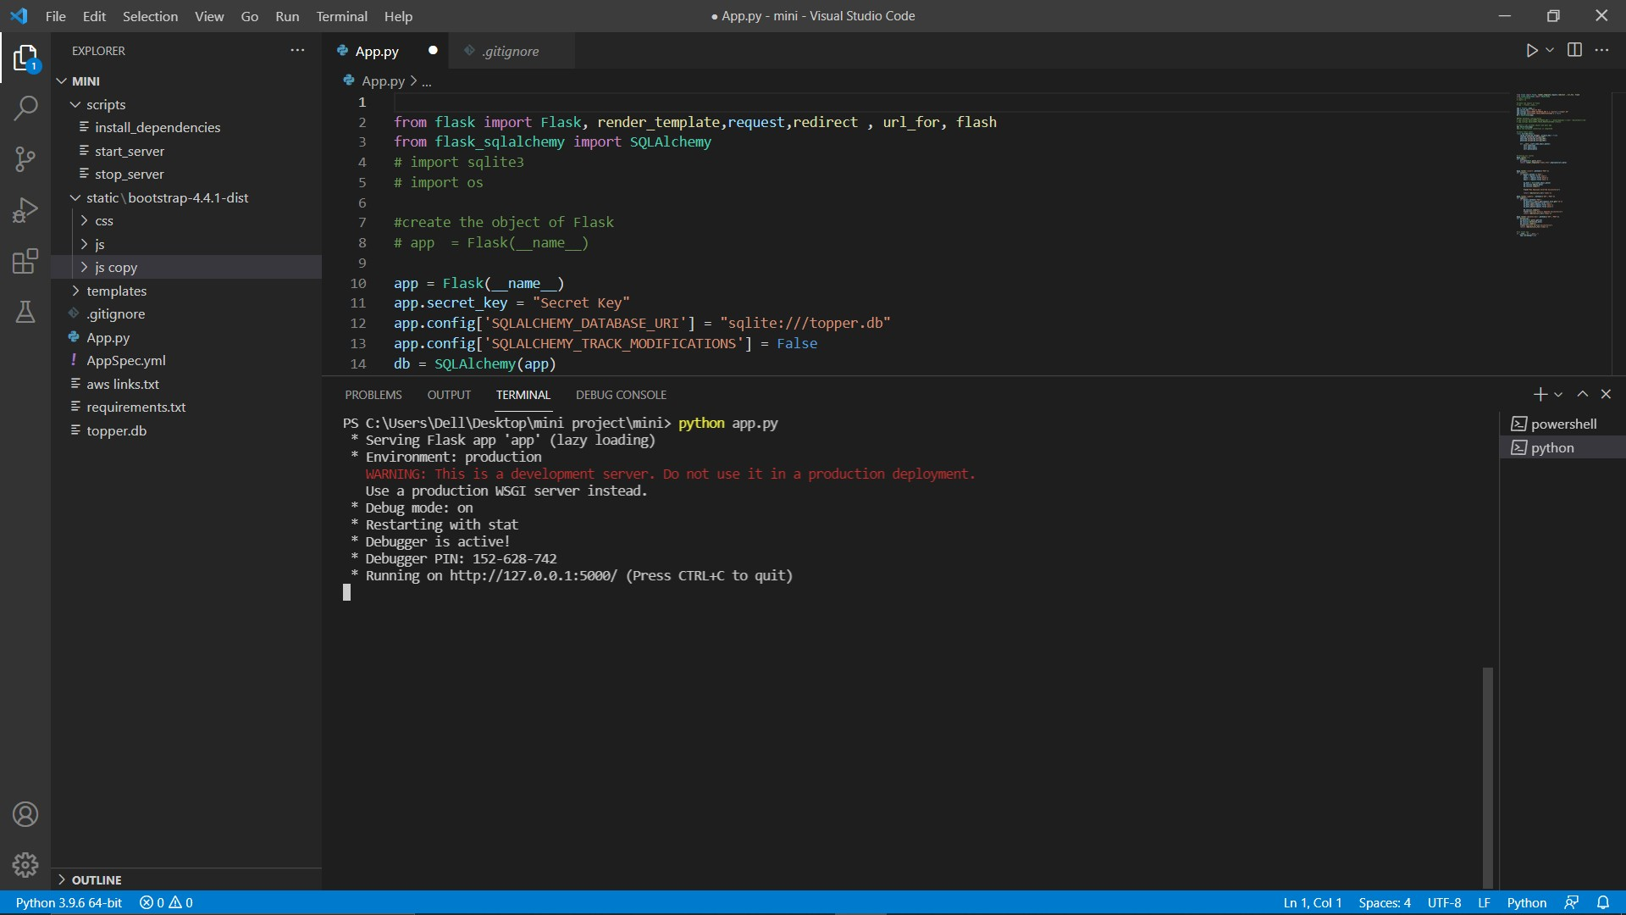
Add your code in app.py.
Add your css and scripts in static folder.
:

Slide 10
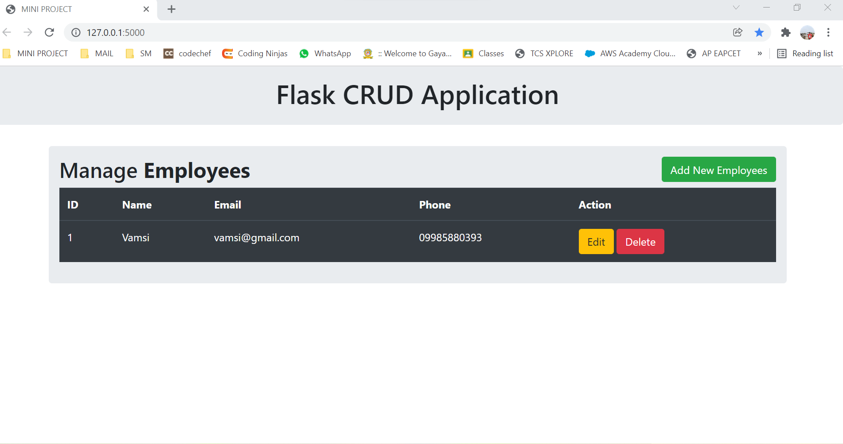
Flask Web Application will be displayed as follows:

Slide 11
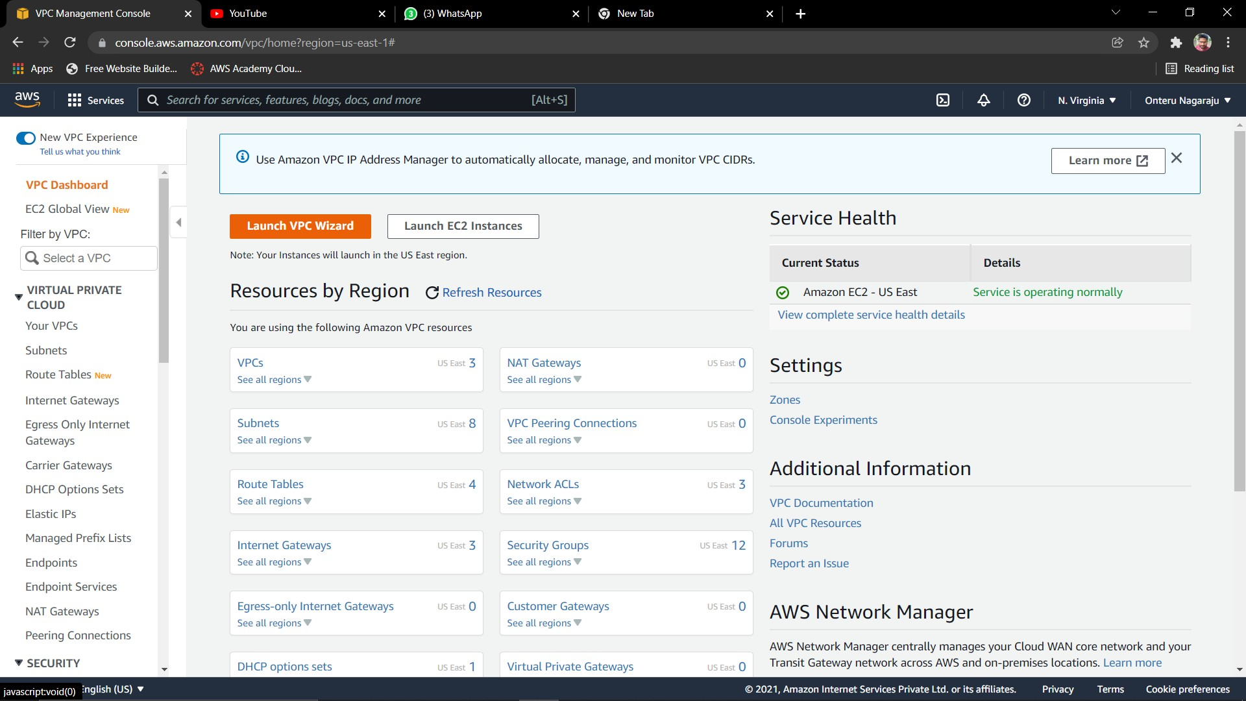
Create Non-Default VPC
.

Slide 12
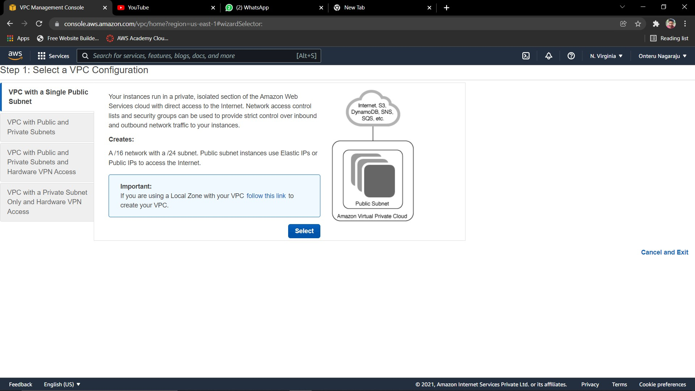
Choose VPC with a Single Public Subnet, and then choose Select.
.

Slide 13
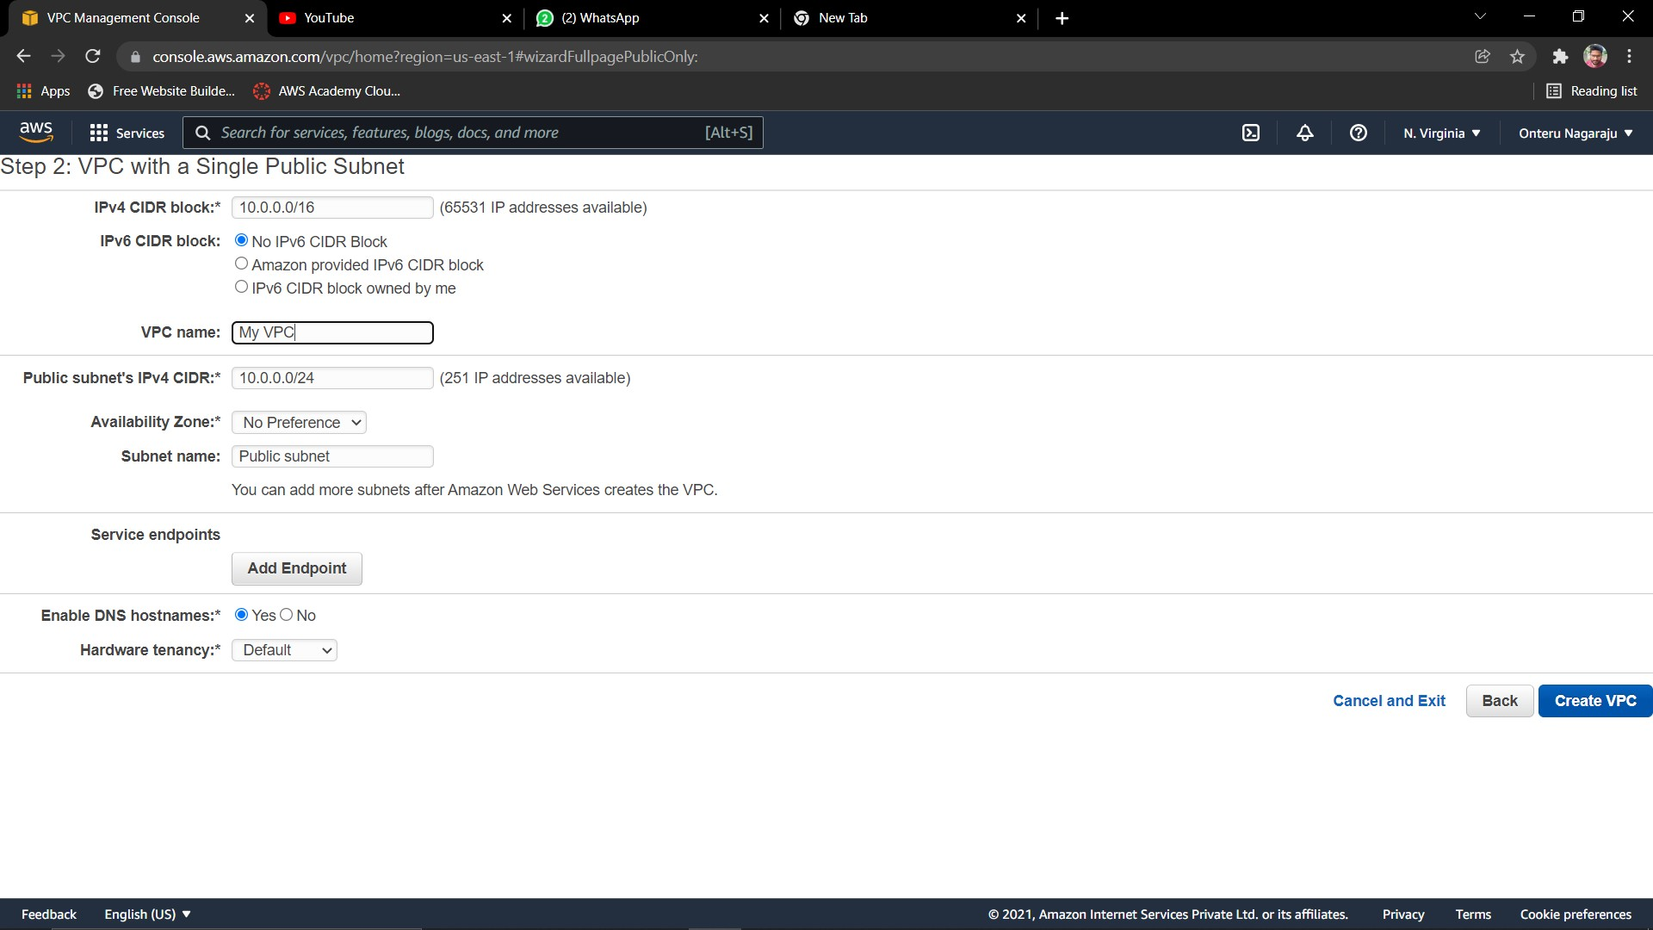
. On the configuration page, enter a name for your VPC in the VPC name field and a name for your subnet in the Subnet name field. Leave the rest of the configuration settings on the page, and choose Create VPC

Slide 14
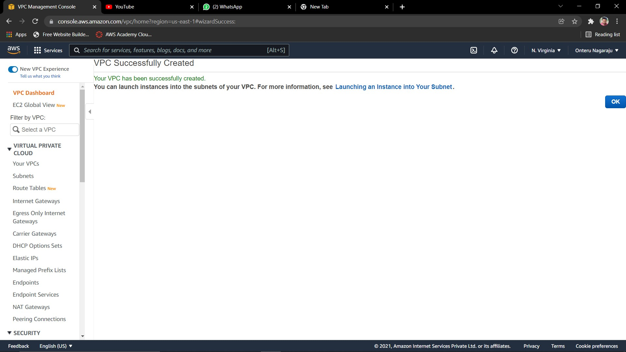
.

Slide 15
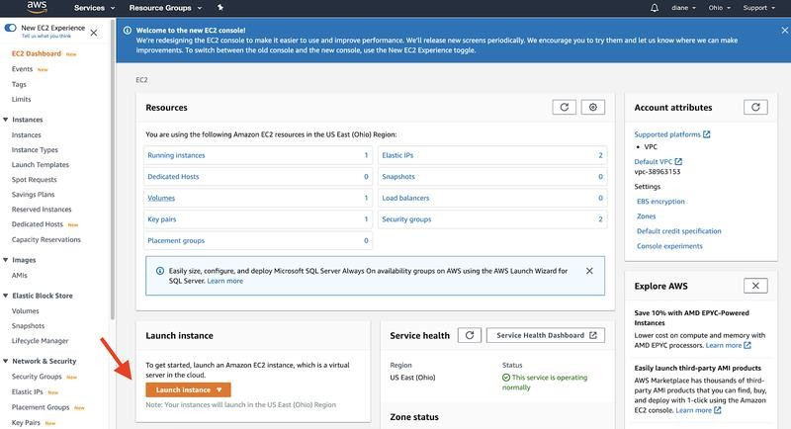
Create and launch an Amazon EC2 instance:

Slide 16
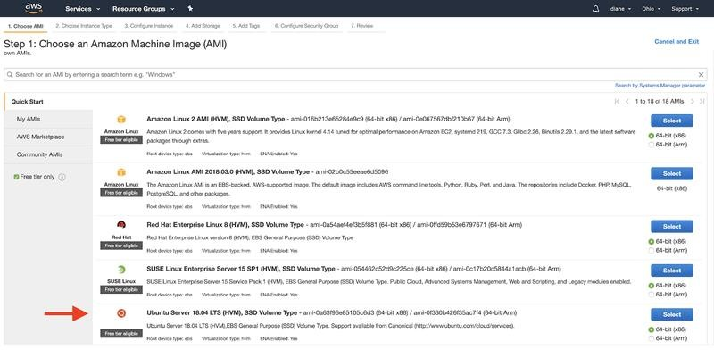

Slide 17
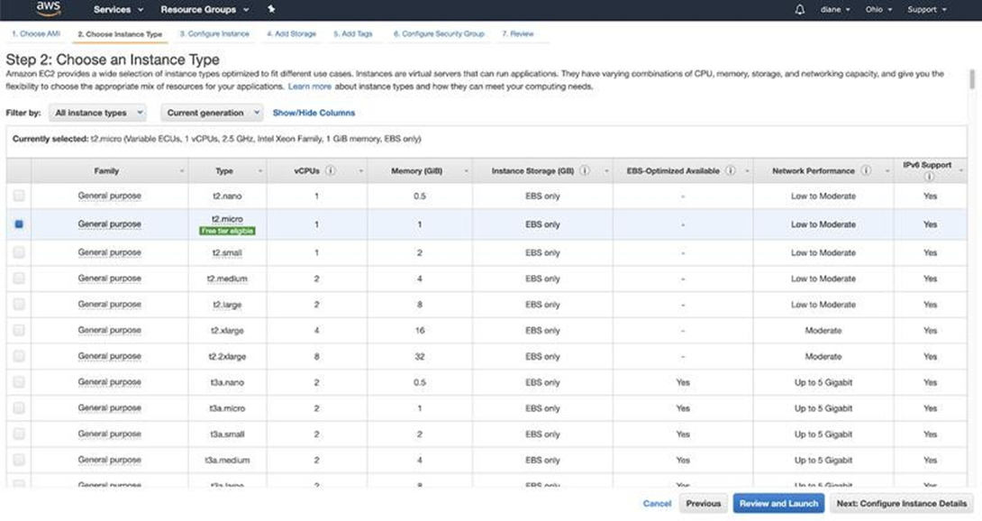

Slide 18
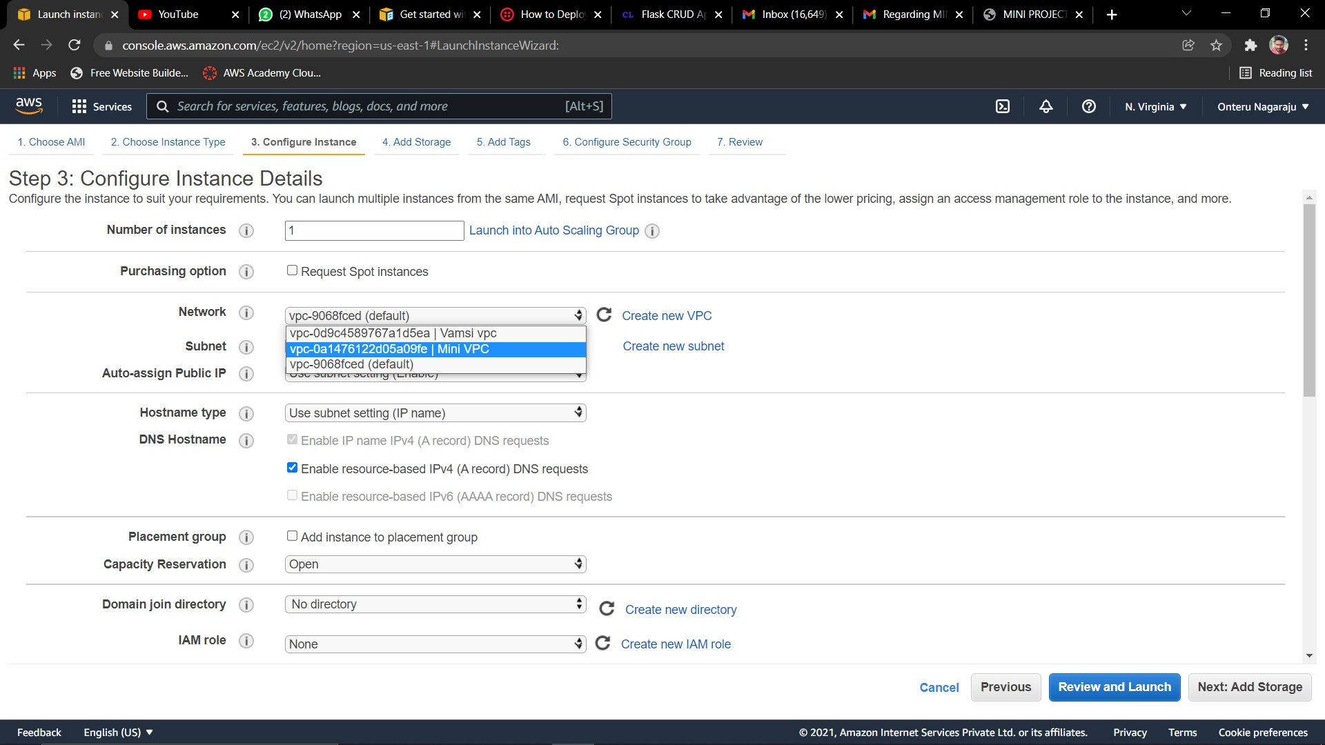
.
.

Slide 19
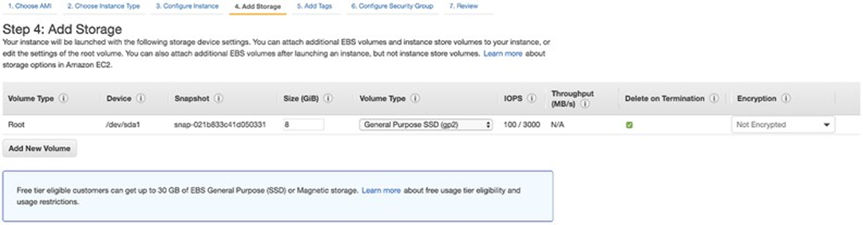
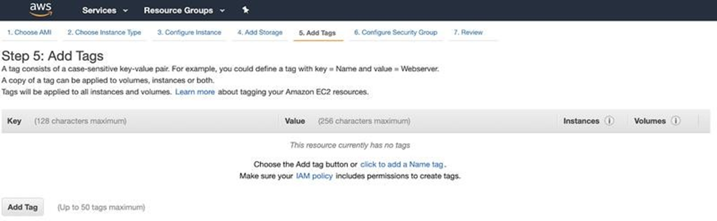

Slide 20
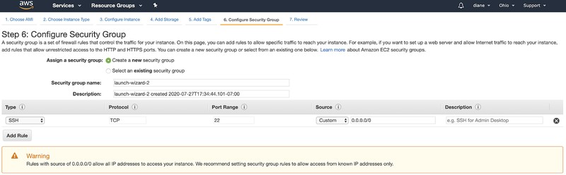
Go ahead and click Next: Configure Security Group.
:
Set Type HTTP, Protocol TCP, Port range 80, and Source to “0.0.0.0/0”.
Set Type HTTP, Protocol TCP, Port range 80, and Source to “::/0”.
Set Type Custom TCP, Protocol TCP, Port range 8080, and Source to “0.0.0.0/0”.
Set Type SSH, Protocol TCP, Port range 22, and Source to “0.0.0.0/0”.
Set Type HTTPS, Protocol TCP, Port range 443, and Source to “0.0.0.0/0”.

Slide 21
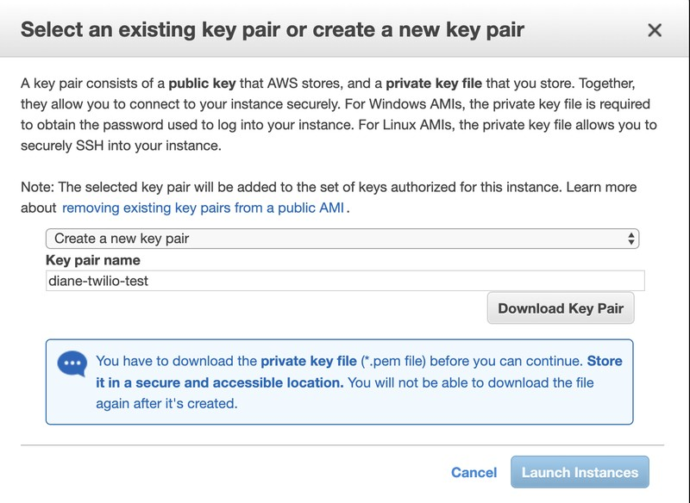
Launch and create a key pair
Review and launch the instance

Slide 22
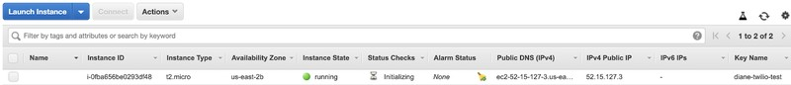
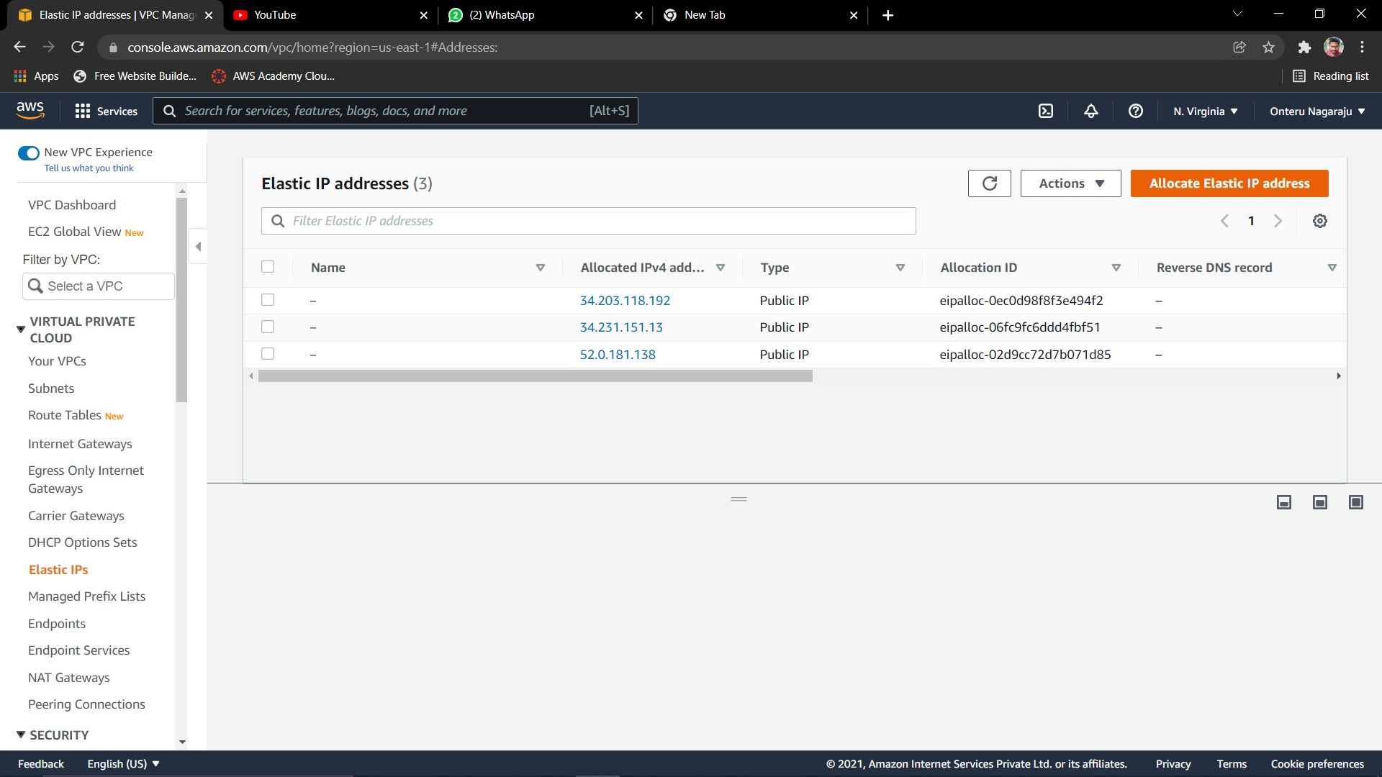
Assign an Elastic IP address to your instance
.
Choose Allocate new address, and then Allocate.

Slide 23
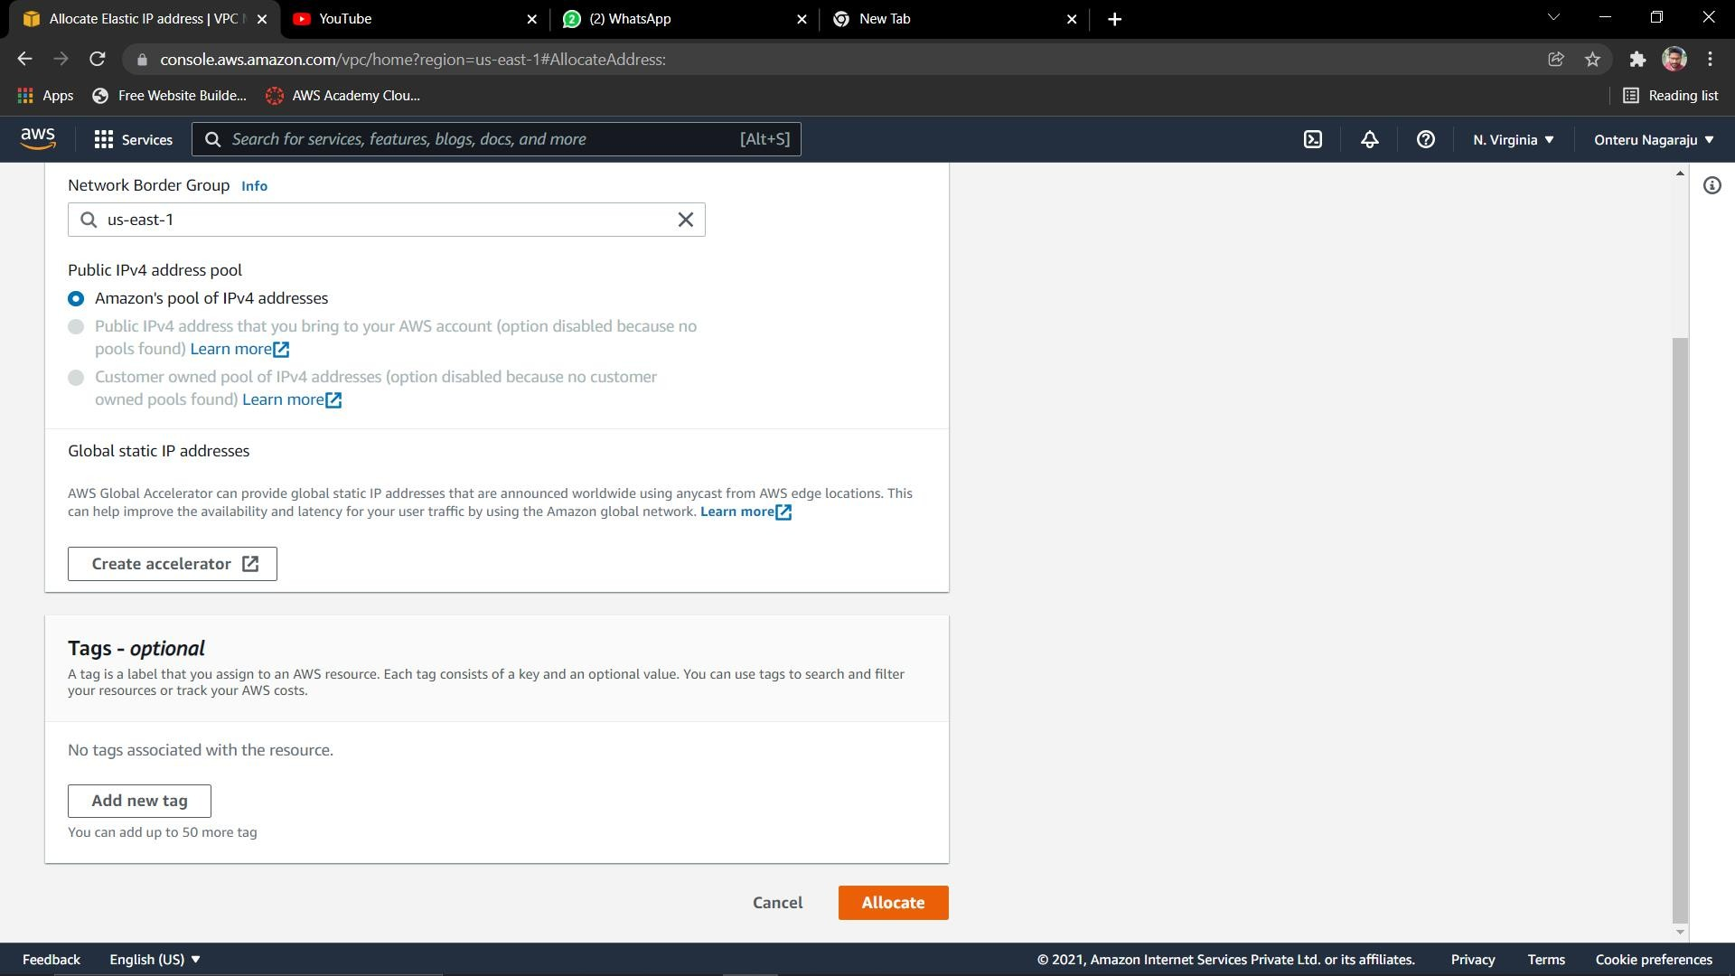

Slide 24
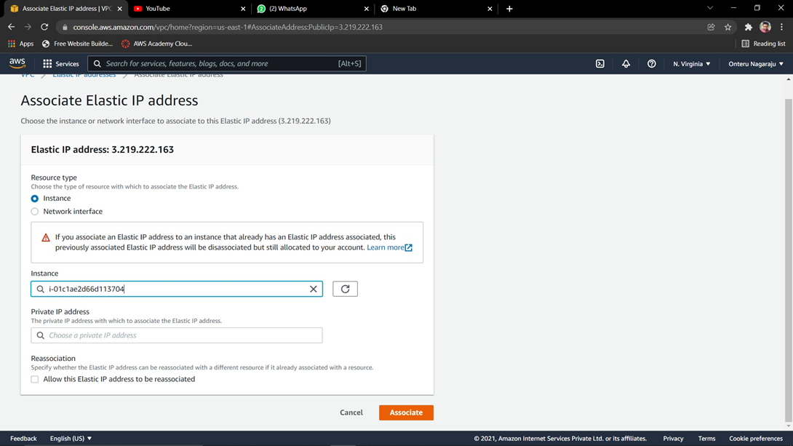

Slide 25
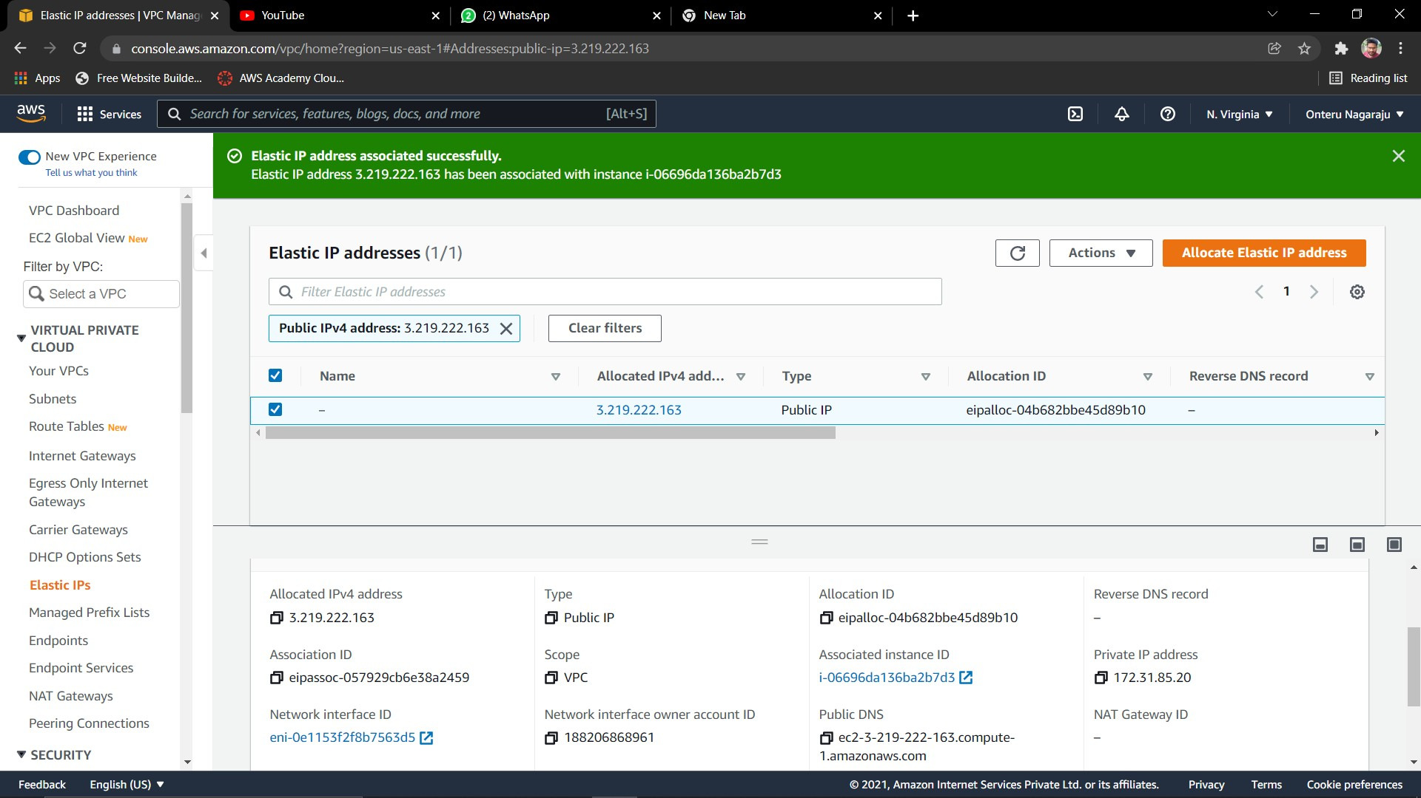

Slide 26
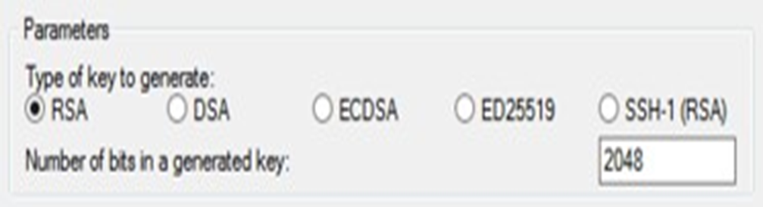
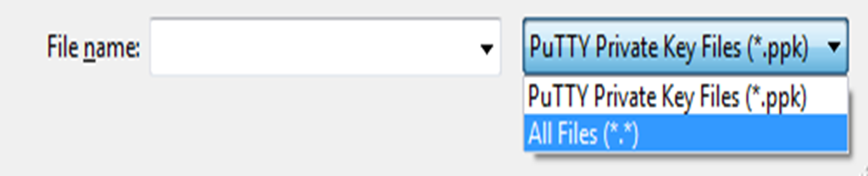
Connect to your Linux instance from Windows using PuTTY
The following instructions explain how to connect to your instance using PuTTY, a free SSH client for Windows.
Prerequisites
Verify that the instance is read
Install PuTTY on your local computer
Convert your private key using PuTTYgen
To convert your private key

Slide 27
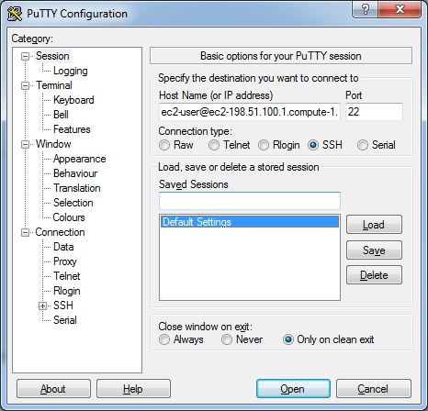
To connect to your instance using PuTTY
.

Slide 28

After Opening clone the project into virtual machine using the following command

Slide 29


Slide 30
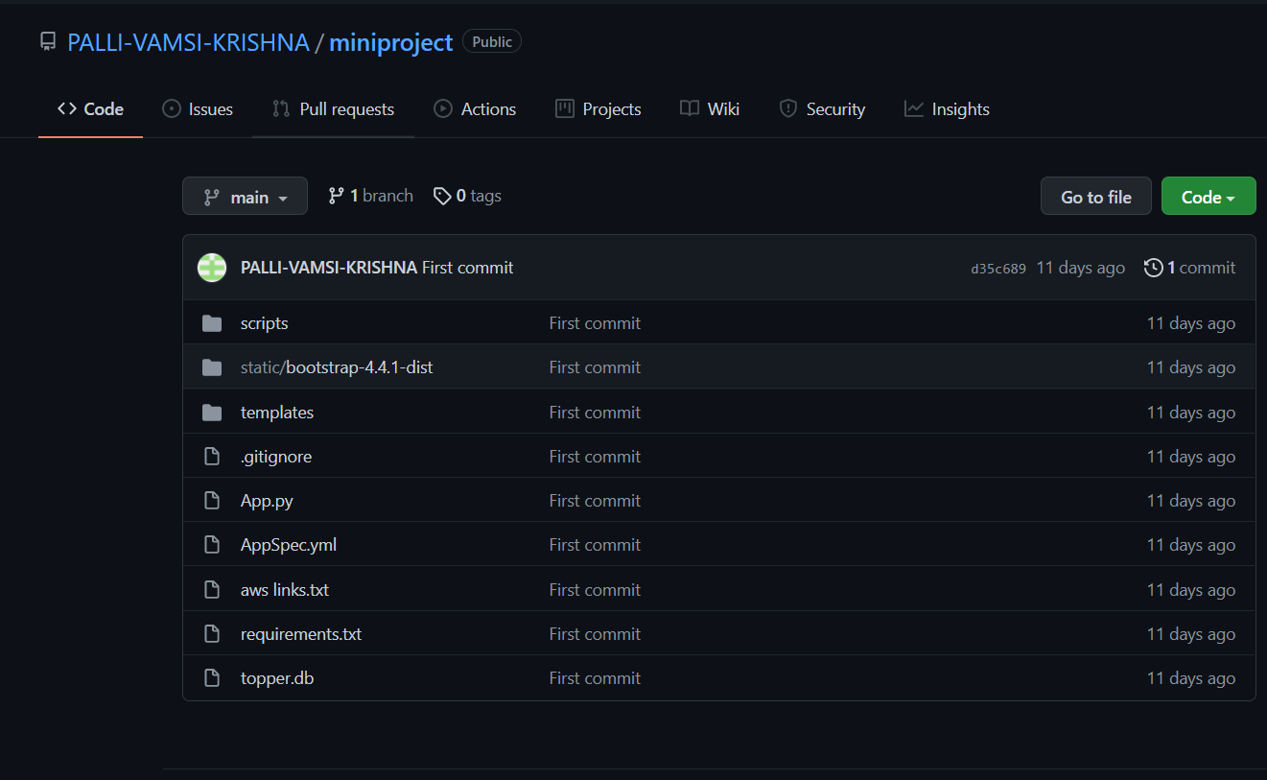
All the project files are pushed into the GitHub repository and will later be cloned in the Linux terminal of the EC2 Instance.

Slide 31
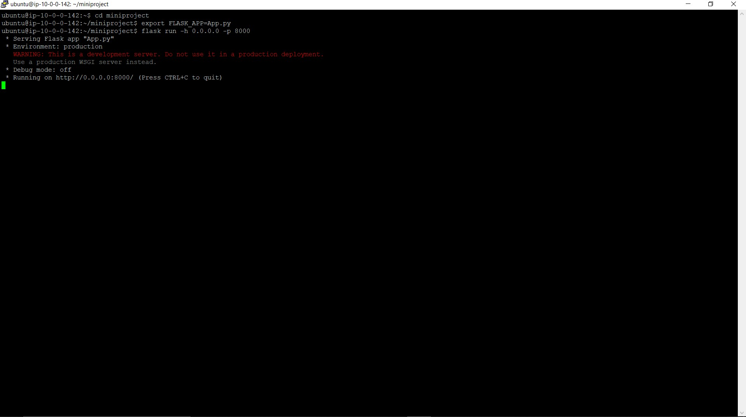
git clone https://github.com/PALLI-VAMSI- KRISHNA/miniproject.git
Now go to project folder and run the application using following commands
export FLASK_APP=App.py
flask run -h 0.0.0.0 –p 8000

Slide 32
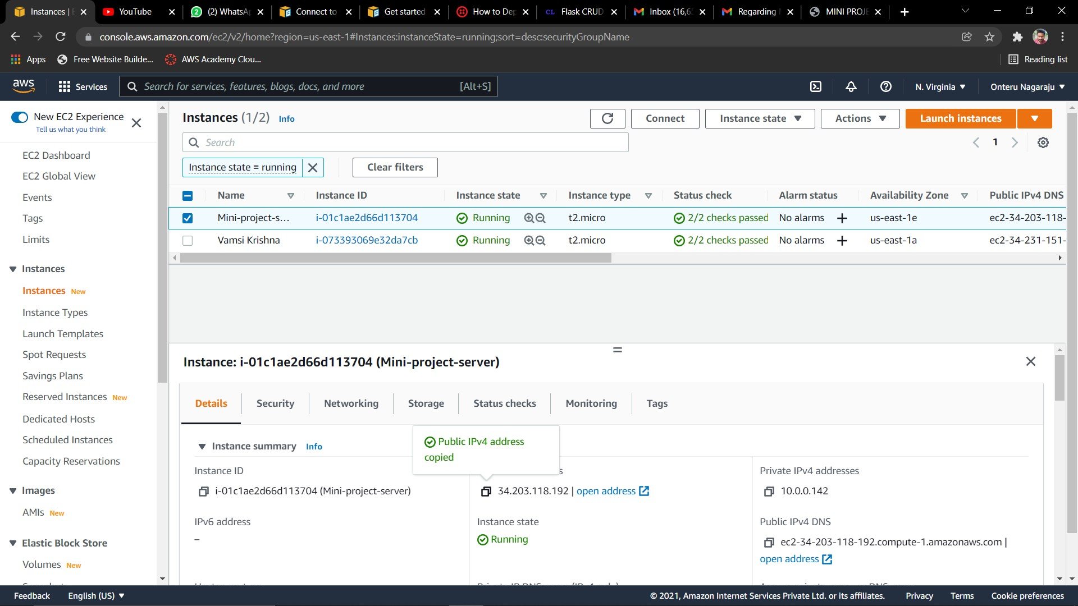
Now our flask application is running.
Copy the Public IPV4 address of our ec2 instance
.

Slide 33
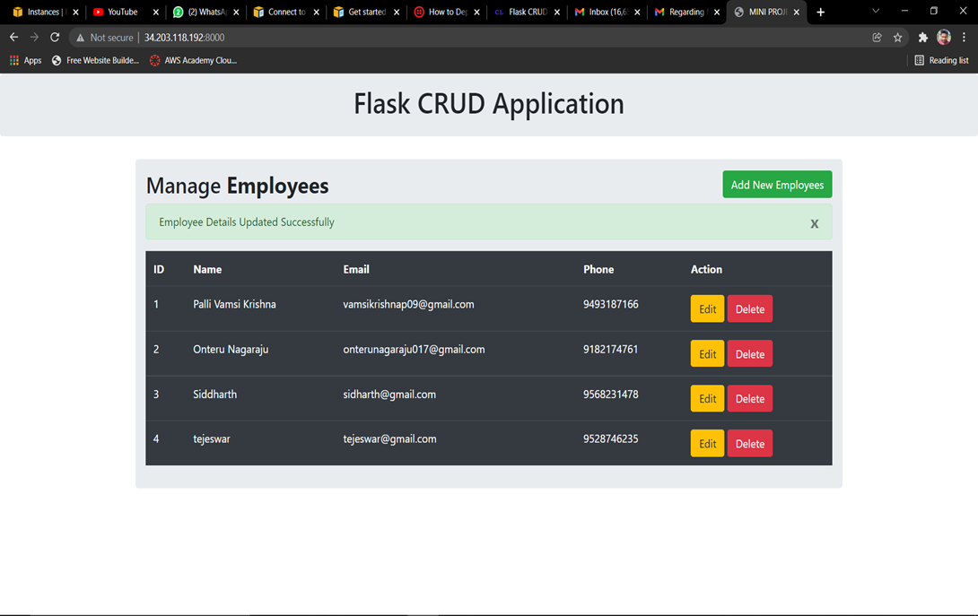
Results In Discussion
Type the IPV4 address in address bar along with port number and enter
Now our website is ready

Slide 34
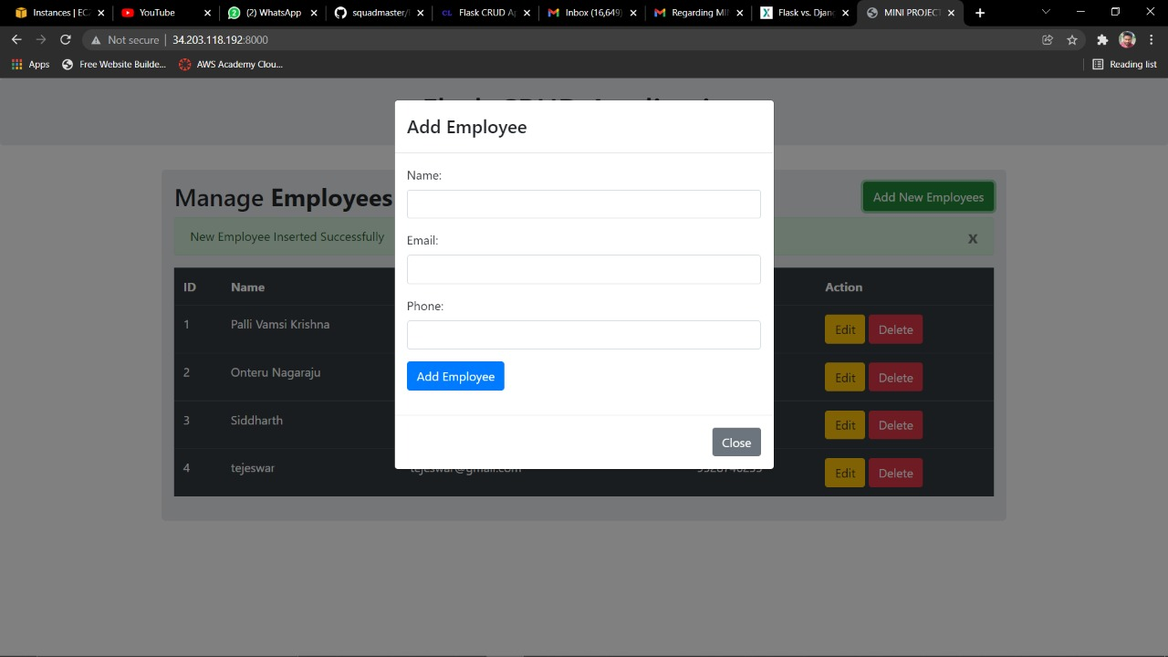

Slide 35
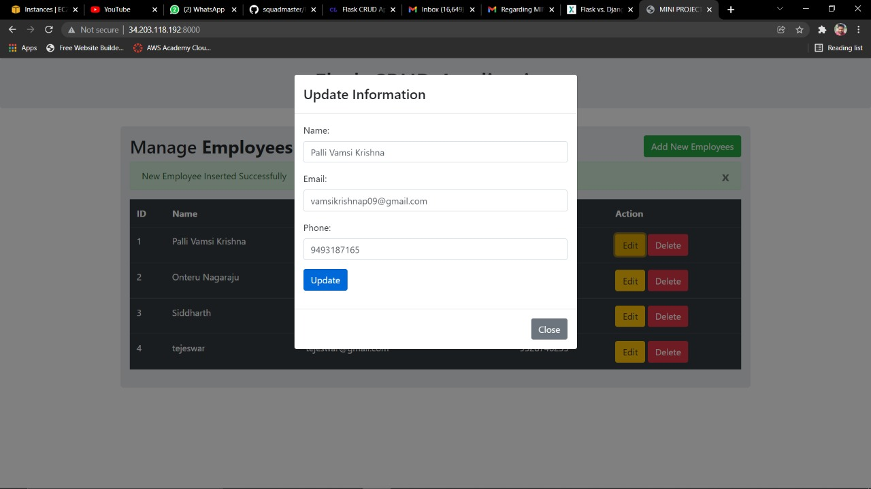

Slide 36
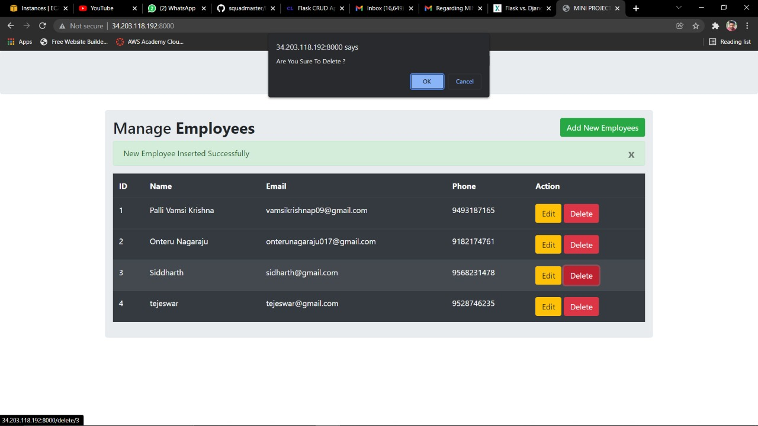
Result :
The Application when launched will be displayed as follows
The Employee Data can thus be Created ,Read ,Updated and Deleted (CRUD Database Operation)
To launch the Application type the command:
export FLASK_APP=App.py
flask run -h 0.0.0.0 –p 8000
Now type the public IP address along with the port number separated by a colon.

Slide 37
CONCLUSIONS:
We can create your own address
We can create as many subnets as required irrespective of public or private
We can restrict access to the users
We can launch any number of instances and attain security to our web application

Slide 38
References:
References:
Cloud Services - Amazon Web Services (AWS)
https://aws.amazon.com
Stack Overflow - Where Developers Learn, Share, & Build ...
https://stackoverflow.com/
https://flask.palletsprojects.com/en/2.0.x/

Slide 39


